Slide 1
Gen-VQA: Generative Visual Question Answering with Abstract Scenes
Yifan Yang, Zhen Guo

Slide 2
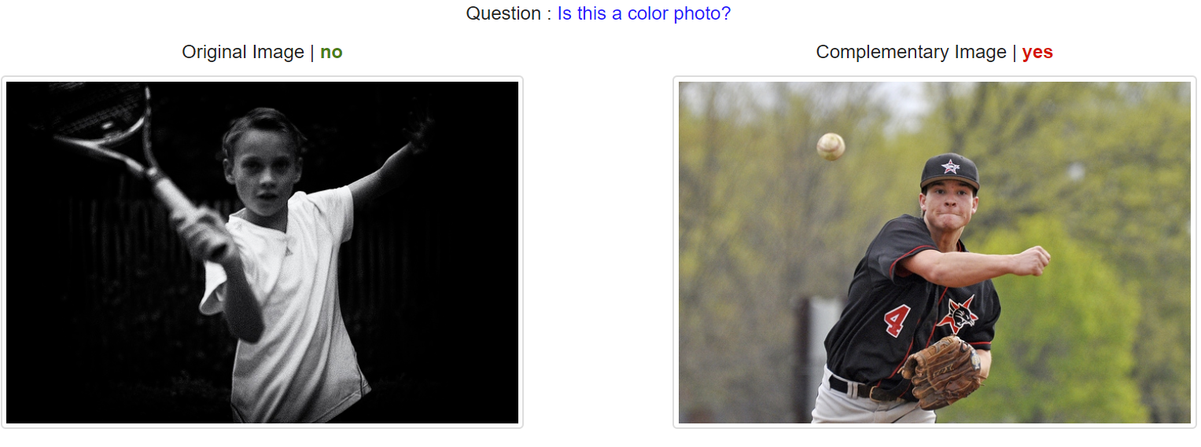
Background
V for Visual
Q for Question
A for Answering
VQA v2 example datasets
Notes:
What is VQA task?
It’s a AI task that combines Computer Vision (CV), Natural Language Processing (NLP) and Knowledge Representation Reasoning (KR) in one.
Here is an example of VQA task
Given a question “is this a color photo”, and an image, the machine are expected to yield answer such as yes or no.

Slide 3
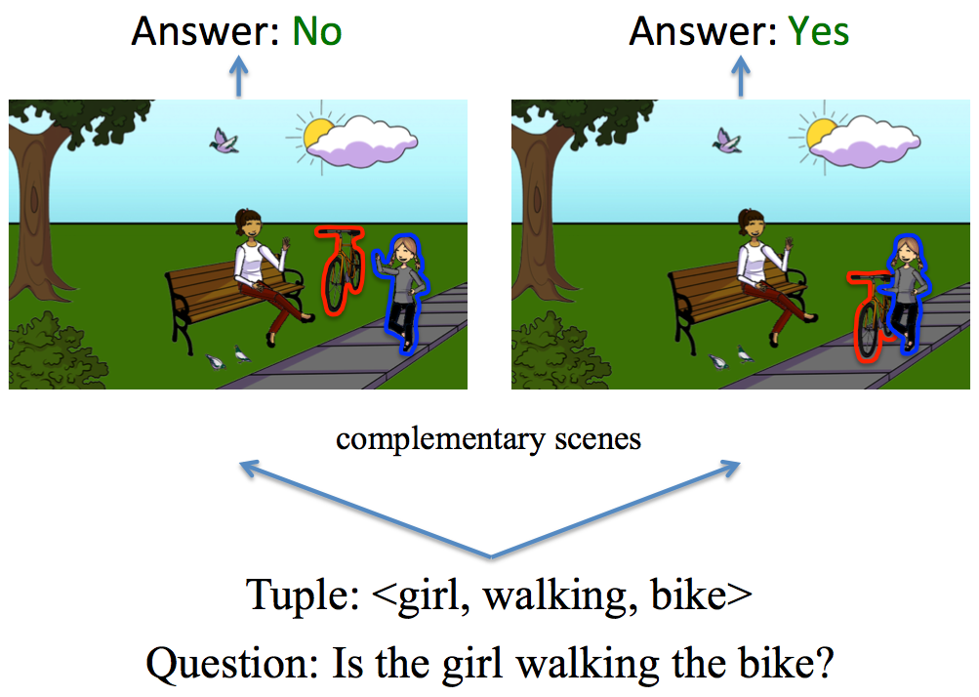
Motivation
Multimodal task is challenging.
Datasets for VQA are scarce, takes a lots of human effort to produce.
Current VQA model heavily rely on human labeled datasets.
Unsatisfactory accuracy.
https://visualqa.org/
Notes:
Motivation改成两点
1 scarce datasets (issues of VQA task)
2 generative model good performance

Slide 4
Solution?
Generating more VQA data for training on the fly!

Slide 5
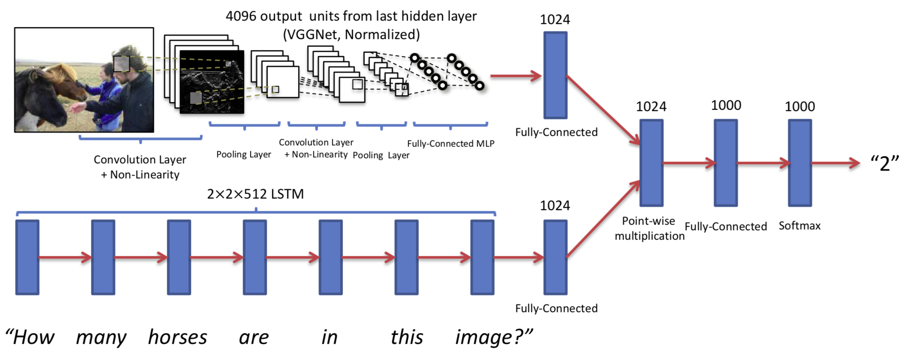
Related Works
Basic VQA: VGGNet + LSTM
Antol, Stanislaw, et al. "Vqa: Visual question answering." Proceedings of the IEEE international conference on computer vision. 2015.
Notes:
Let’s take a look at the basic VQA model
VGGnet is huge, even though there is network has large capacity, no enough data to train, and low accuracy (only about 50%~)

Slide 6
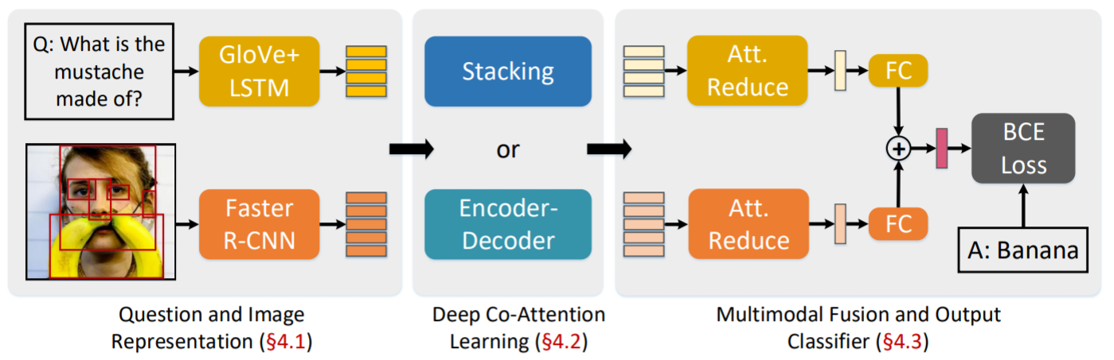
Deep Co-Attention Networks
Yu, Zhou, et al. "Deep Modular Co-Attention Networks for Visual Question Answering." Proceedings of the IEEE Conference on Computer Vision and Pattern Recognition. 2019.
Notes:
Additional co-attention module
Like basic VQA, still suffer from data scarcity

Slide 7
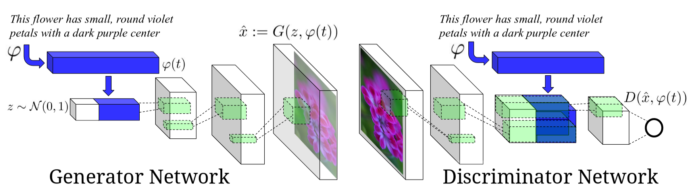
How to Overcome Data shortage?
Text to Image GANs (Generator module)
Reed, Scott, et al. "Generative adversarial text to image synthesis." arXiv preprint arXiv:1605.05396 (2016).
Notes:
How to overcome Data shortage in VQA
we found that GANs is an ideal platform for text-to-image generation.
Here, a text-to-image GANs will takes a language description of flower as input, and output a flower image that corresponds to the description.
Therefore, inspired by this network, we integrated the generator module in our architecture, use question-and-answer pairs to generate an image

Slide 8
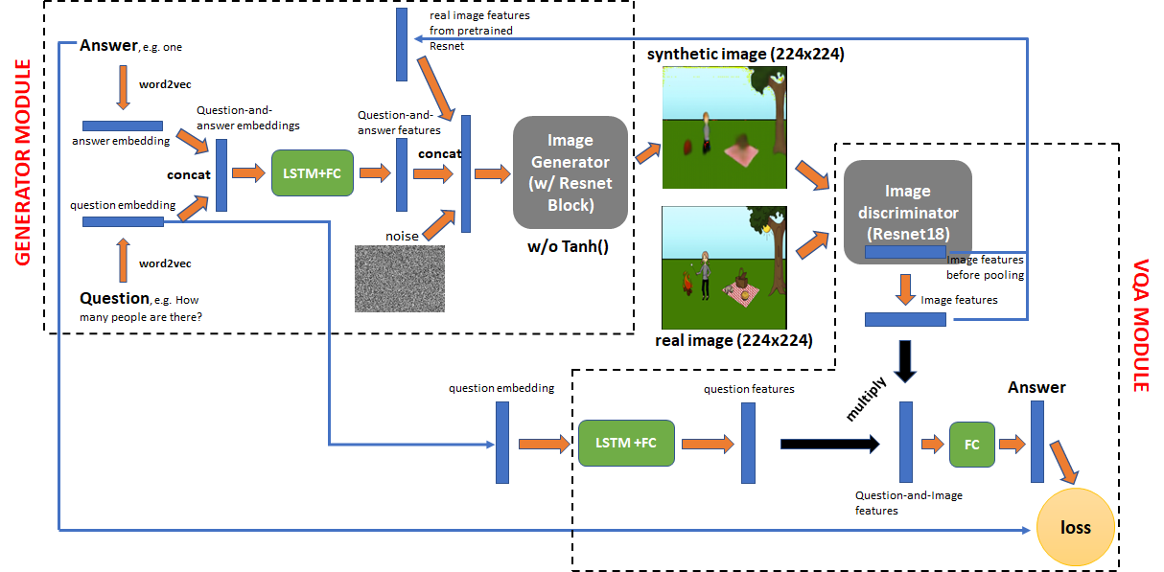
Gen-VQA Architecture
Notes:
Mention the scope of our model/approach
Similar to GANs, our model contains 2 major components, the generator and the discriminator.
The generator generates synthetic image with the same VQA answer as the real image.
We feed the gaussian noise, question-answer features extracted from LSTM and low-dimensional real image features extracted from pretrained resnet18 to the generator to synthesize high-resolution image for the VQA task.
The generator architecture is inspired by resnet, where upsample layers are inserted between resnet blocks instead of downsample layers.
The discriminator performs VQA task on both real image and synthetic image.
It’s similar to the basic VQA model where resnet18 is used to extract image features and LSTM extracts question features.
In this way, the generator can be treated as a data augmentation method for the VQA module to create more VQA data out of the current dataset.

Slide 9
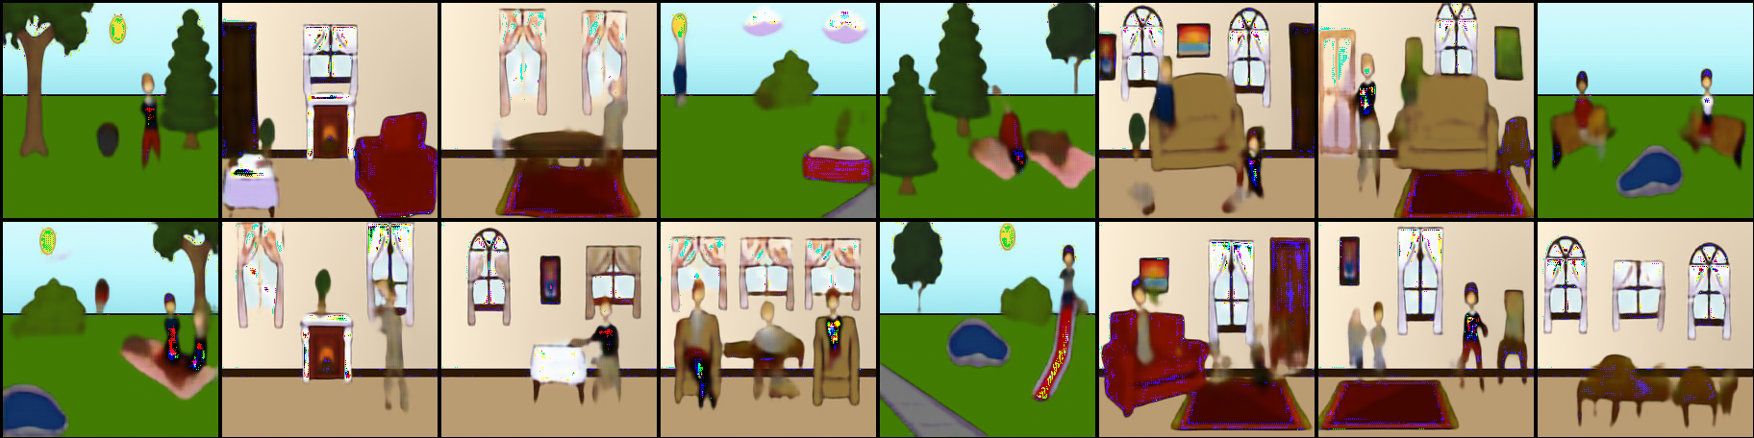
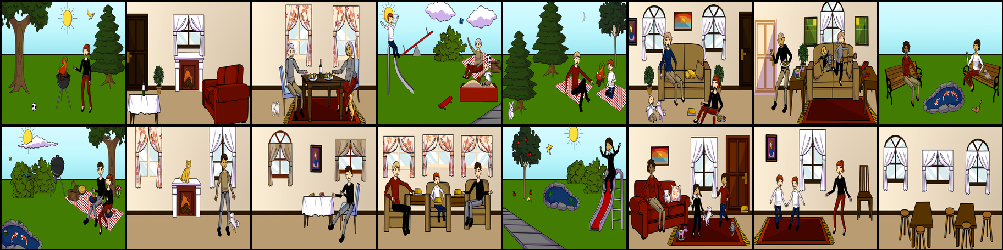
Generated Images
Notes:
Let’s first visualize the generated images.
On the top is the synthetic image and bottom is the real image.
The synthetic image preserves most of the information from real images with perturbation such as colors and shapes.
After making sure the image generator works, we show the accuracy results of Gen-VQA model after 30 epochs of training.

Slide 10
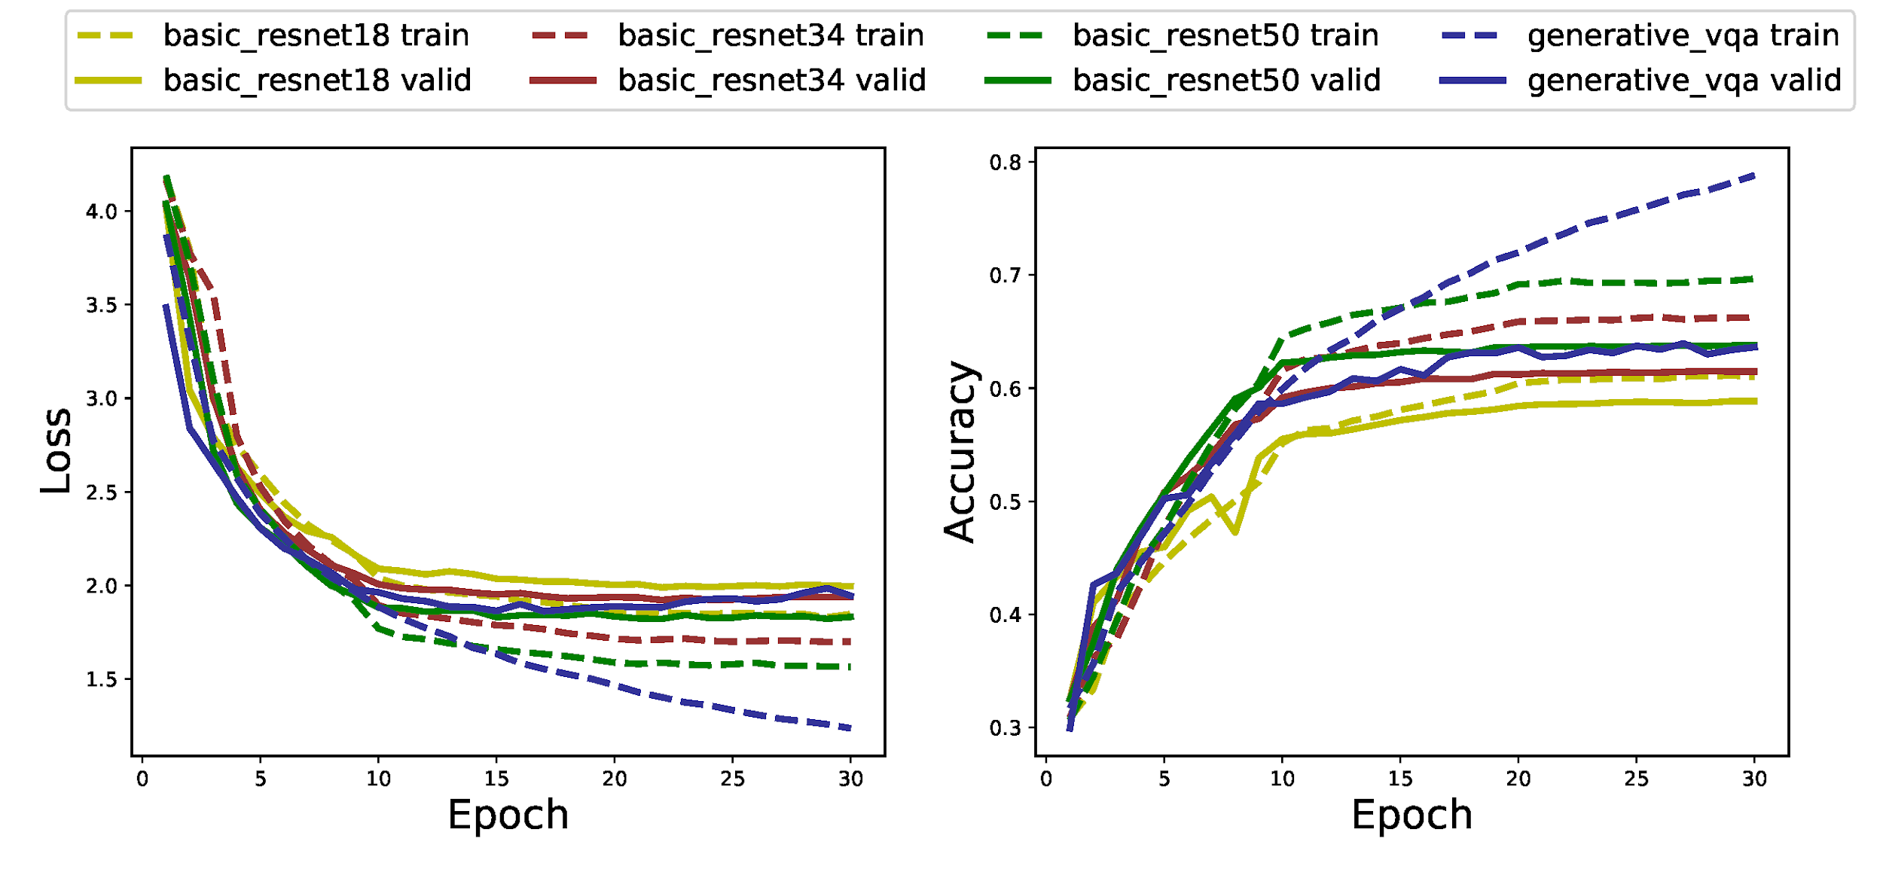
Results
Notes:
The training curve is shown here.
We use the basic VQA as baseline and evaluate its accuracy using resnet18, 34 and 50 as feature extractor.
Our generative VQA uses resnet18 to understand image and is shown in blue curve.
As we can see from the curve, our generative model achieves an accuracy of 64% on validation set, which is 5% higher than basic vqa using the same resnet18.
Our model achieves best accuracy among all the variants of basic vqa.

Slide 11
Results
 | Basic resnet18 | Basic resnet34 | Basic resnet50 | Ours resnet18
Param size | 11.7M | 21.8M | 25.6M | 11.7M
Accuracy | 58.9% | 61.5% | 63.8% | 64.0%
Notes:
We further calculate the parameter size of each model.
With half of the parameters, the Gen-VQA obtains higher accuracy with the resnet50 equipped basic VQA.
This shows the power of our generative VQA on augmenting the datasets and improving model accuracy.
As we can see from the table, although our model has smallest size, we achieve the best accuracy compared to all 3 baselines.

Slide 12
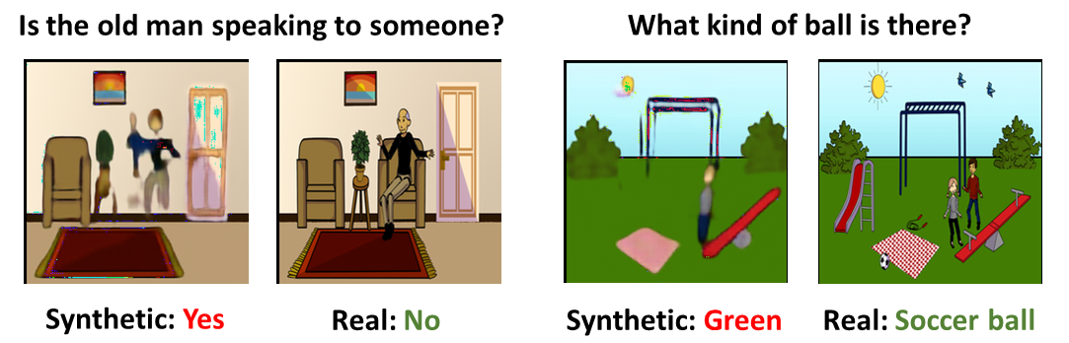
Limitations and Future Works
Notes:
Let’s look at the failure case of our network.
In these two cases, the reconstruction fails to synthesize the soccer ball so that the answer to question “what kind of ball is there?” is incorrect.

Slide 13
Limitations and Future Works
Variation on synthetic images are not enough
Restricted to abstract scene.
Not including open-form questions.
Notes:
Other limitations are:
The variation on synthetic images are not enough.
The current model is restricted to abstract scene and not including open-form questions.
Future model can improve on these aspect.

Slide 14
Conclusion
https://github.com/Yang-YiFan/vqa-gan
Notes:
We open sourced our code on github.
In this work we design and implement a generative model for visual question answering, which generates realistic training images and can improve accuracy of the VQA model.
With that, we are open to questions.

Slide 15
Q&A

Slide 16
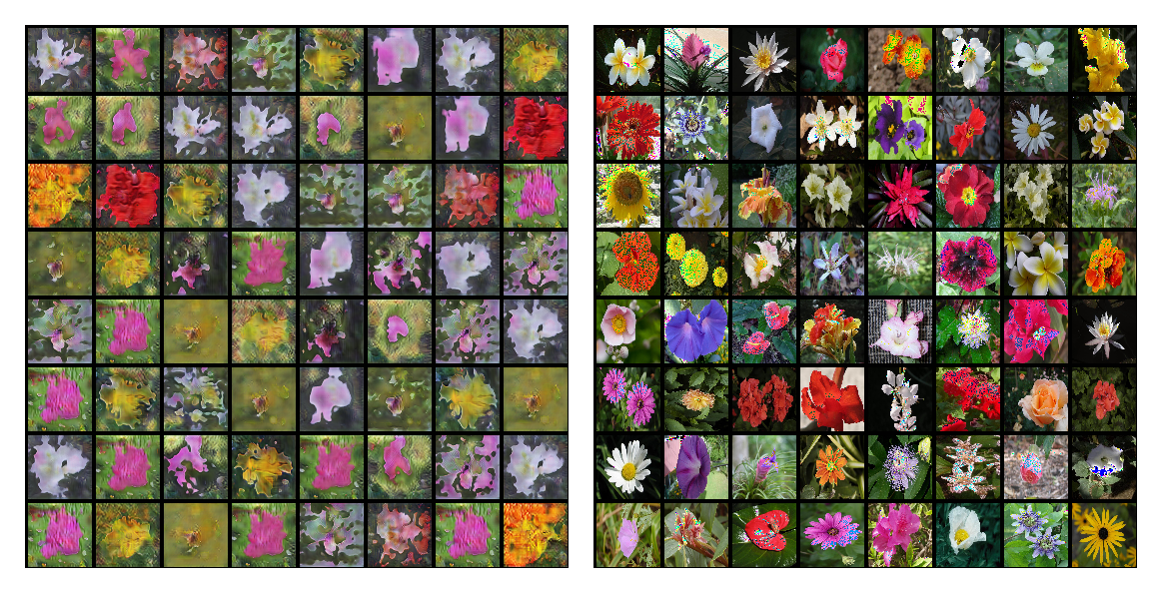
Additional Information
resnet model collapse

Slide 17
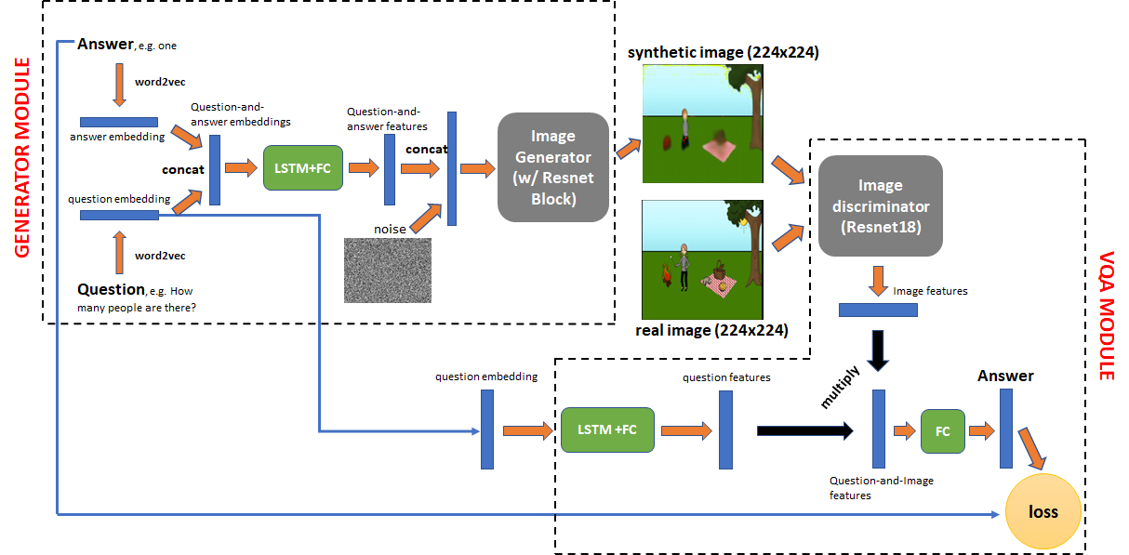
Our approach
Notes:
Mention the scope of our model/approach
Our model contains 2 major components.
The generator generates synthetic image with the same VQA answer as the real image.
The discriminator performs VQA task on both real image and synthetic image.
In this way, the generator can be treated as a data augmentation method for the VQA module to create more VQA data out of the current dataset.
In order to generate the same answer as the real image, the generator takes both the VQA question and answer as the input.
The question and answer are first casted into embedding vectors and then concatenated together.
The concatenated embedding then goes through a LSTM and FC module to generate the language feature.
A gaussian noise vector is concatenated with the language feature and fed into the image generator.
In this way the question and answer constraint the generator’s output.
The generator has a resnet inspired architecture.
We chain multiple resnet blocks together and insert upsample layer between blocks.
The output of the generator is a 224x224 abstract scene of the VQA dataset.
The discriminator is effectively a basic VQA module with resnet18 and LSTM to understand the input image and question respectively.
We use both the real and synthetic image to train the VQA module.

Slide 18
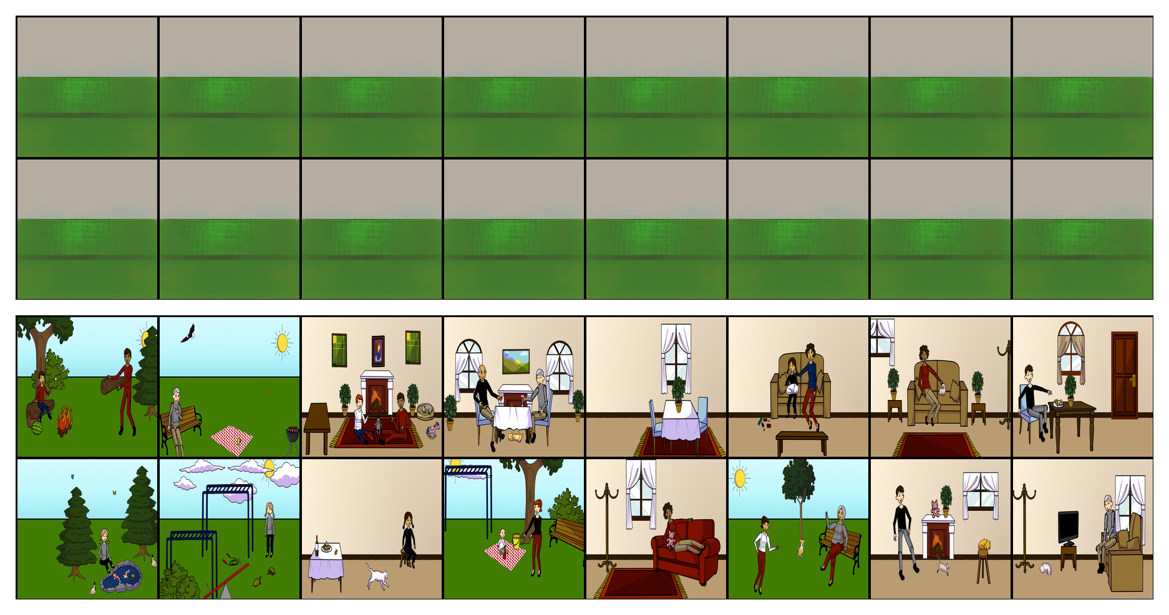
Generated Images
Notes:
Mention the scope of our model/approach
Let’s first look at the generated images by our model.

Slide 19
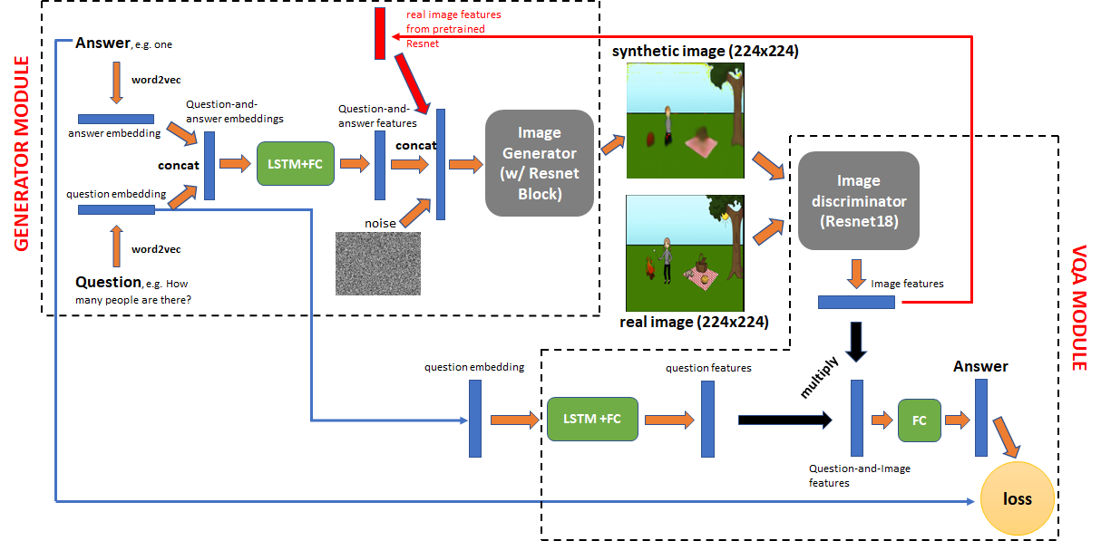
Our approach
Notes:
Mention the scope of our model/approach

Slide 20
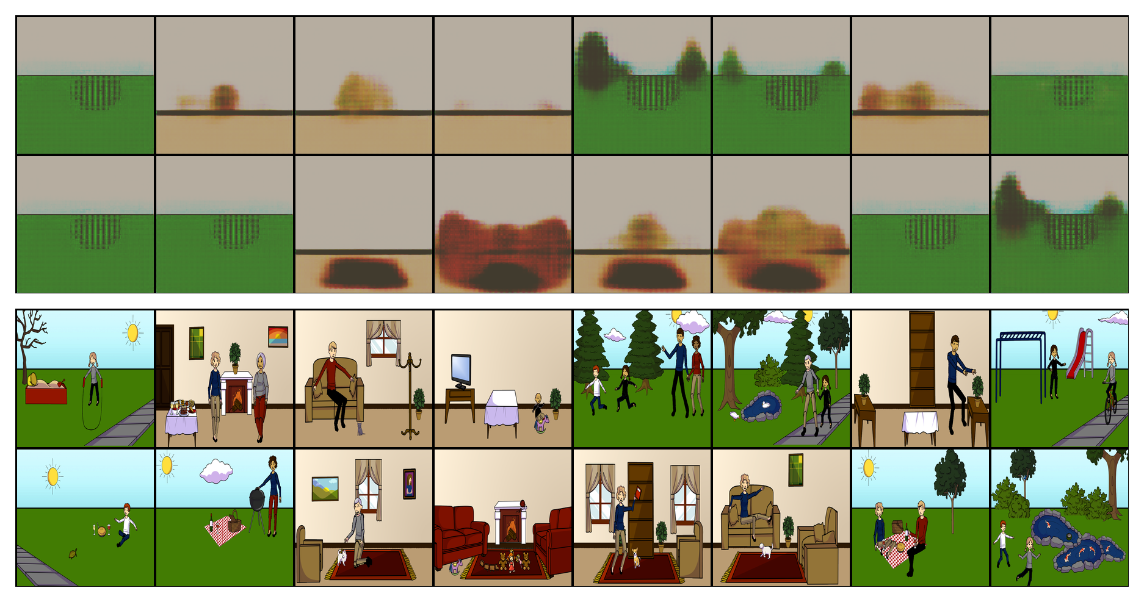
Generated Images
Notes:
Mention the scope of our model/approach

Slide 21
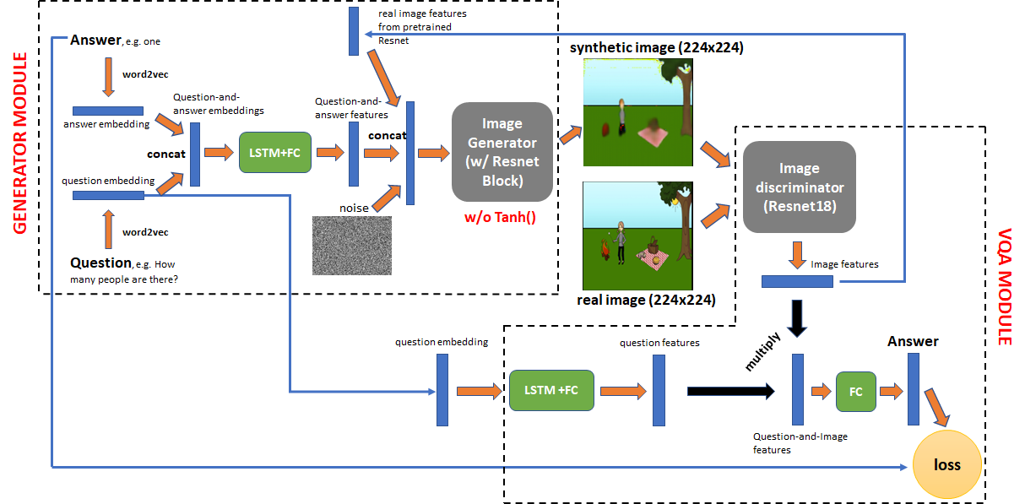
Our approach
Notes:
Mention the scope of our model/approach

Slide 22
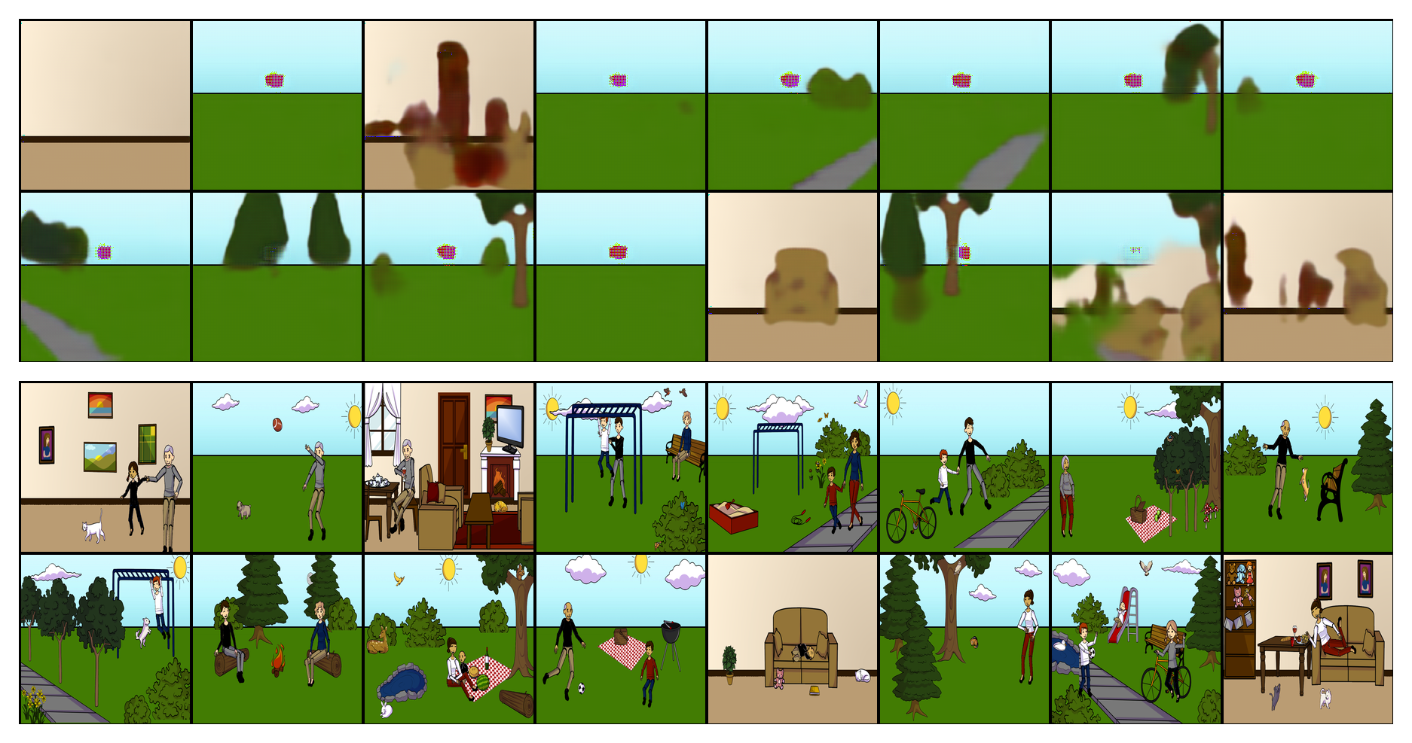
Generated Images
Notes:
Mention the scope of our model/approach

Slide 23
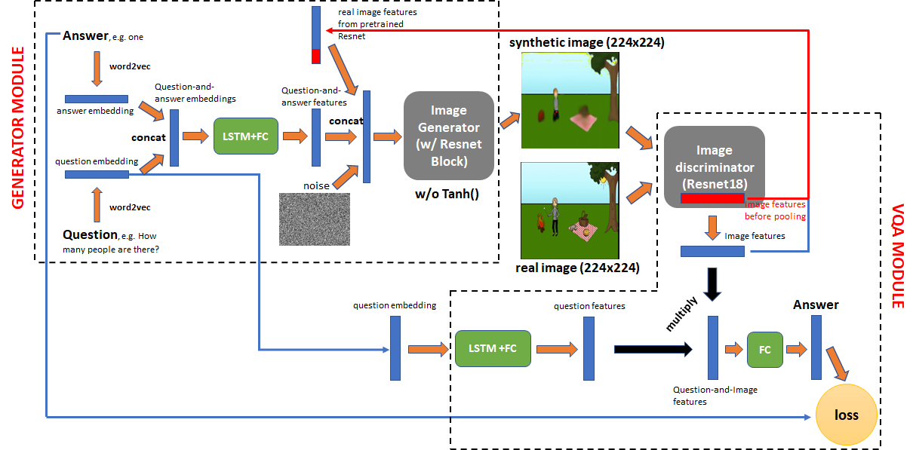
Our approach
Notes:
Mention the scope of our model/approach

Slide 24
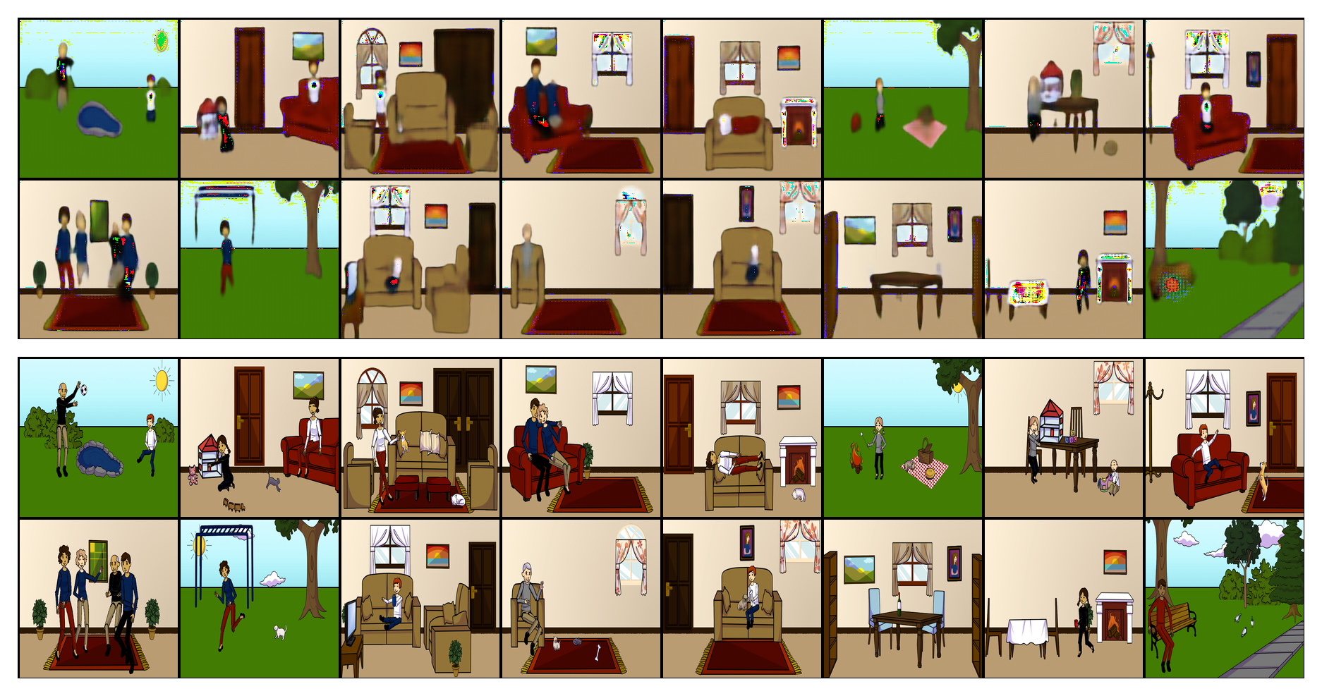
Generated Images
Notes:
After making sure the image generator works, we train the whole Gen-VQA model 30 epochs on amazon AWS.

Slide 25
remove Tanh Layer
only with question-and-answer pair embedding

Slide 26
last layer + second last layer features

Slide 27
Generated Images
Notes:
Let’s first visualize the generated images.
On the top is the synthetic image and bottom is the real image.
The synthetic image preserves most of the information from real images with perturbation on color and shape of objects.
After making sure the image generator works, we show the accuracy results of Gen-VQA model after 30 epochs of training.

